Slide 1
The Interview Process
Week 3, Unit 3
CC11 Communication in the Workplace
Bretz Harllynne M. Moltio

Slide 2
Table of Contents
Preparing for an interview
Common interview questions
Best practices for an interview
During the interview
After the interview

Slide 3
Job Interview
Most common way for employee selection
Done after the shortlisting of employees using the CV / resume and application letter
Helps clarify the decision making process by asking questions that may not be seen in the CV / resume
A type of structured interview
Interviewer asks questions from a determined list of questions
Interviewee (employee) answers questions
Would vary based on the company and the job

Slide 4
Preparing for an Interview
Dress code | Other best practices

Slide 5
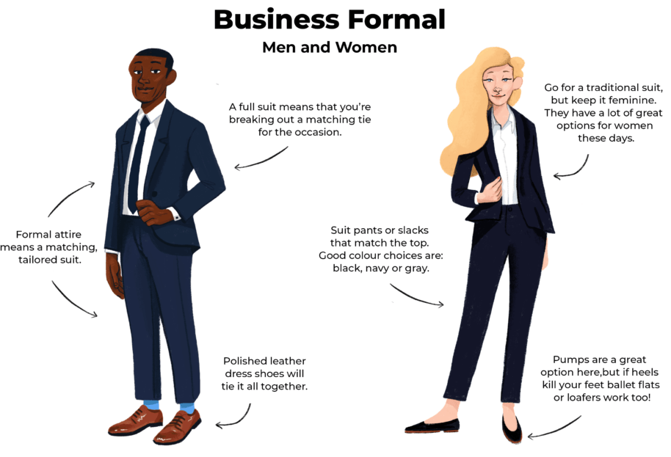
Dress Code
Dress according to the job that you want to take
Safest option: business formal

Slide 6
Other Best Practices
Carefully examine the job description
Research about the company and the role
Set up how you can be the best fit for the company
Practice answering the commonly asked interview questions
Practice speaking voice and body language
Conduct mock interviews
Have your resume / CV on hand

Slide 7
Common Interview Questions

Slide 8
Common Interview Questions
Tell me about yourself.
Why do you want to work in this company?
What are your expectations for this job?
What is your biggest strength?
What is your biggest weakness?
Are you a leader or a team player?
Tell me an experience of when you had a conflict with someone else and how did you resolve it.
Where do you see yourself in 5/10 years?
Why should we hire you?
Do you have any questions for me?

Slide 9
Tell me about yourself.
NOT an invitation for you to talk about your personal life
Focus more on explaining your strongest traits, values, and skills that makes you the best fit for the job and company
For those with experience, focus on your professional and academic experience relevant to the job
For those without experience, you may focus more on your soft skills that fit with the job and company
Lace this with the values and goals of the company to show that you are a best fit
Limit to one minute only

Slide 10
Why do you want to work in this company?
Requires initial research from the company
Be honest on what you think is good about the company
If there is none, there it would be better for you to focus on the job itself
Even though it’s about your choice regarding the job, it would be best if you can add something that you can offer to the company

Slide 11
What are your expectations for this job?
Used to determine your past expectations
Give a lot of focus on what YOU can offer to the company and team
Include what the company and team can offer you last
Prevent adding anything negative regarding this question
Done by those who have had previous negative experience
Not good to talk down to your previous experience / employer
Prevent talking about a specific amount
For another (follow up) question

Slide 12
What is your biggest strength?
Used to determine whether you are the best fit for the company
Narrow down your biggest strength to something that the company and job requires; not the strongest applicant
Best answered with a soft skill
Can be used even those without experience
Still requires some previous experience that would show this strength
Some employers do not want a one-to-one description with their job order

Slide 13
What is your biggest weakness?
Used to determine how you try to improve yourself
Do NOT answer “I do not have any weaknesses”
Too arrogant, resistant to change, or have not had experience
Others would say their biggest weakness hidden as a strength (Example: being a perfectionist)
Be honest, but ensure that your biggest weakness is not critical to the job
Example: being lazy
Include how you are improving yourself to overcome that weakness

Slide 14
Are you a leader or a team player?
Used to see if it’s possible for you to be placed in different scenarios
Recommended to say that you can do both
Say at the beginning “I am comfortable with either, but if I had to choose…”
Sticking to just one means that you are resistant to change or do not want to improve yourself
Still choose one that you are more comfortable with
Recommended to choose one that is best with the job
Explain why you are more comfortable / better with that role

Slide 15
Tell me an experience of when you had a conflict with someone else and how did you resolve it.
Used to determine how you resolve team conflict
Sometimes interpreted as being able to be “the winner” of the conflict, which is untrue
Looks into how you can take everyone’s best interests to resolve the situation
Use the STAR (situation, task, action, result) method
Situation: Specific conflict or challenge seen in your professional or academic work
Task: Your role in the conflict
Action: Steps you took to resolve the conflict
Result: Description of the results of your actions

Slide 16
Where do you see yourself in 5 / 10 years?
Used to see if you have a plan for yourself professionally
Sees if the company can provide that for you
Can also be used to determine company loyalty
Prevent saying “I don’t know”
Focus on the skills you want to have that you can get through the job and company
You can also ask if the company has any career goals
Prevent specifying any job title or company
Some companies are focusing on company loyalty
You may use terms like “managerial” or “upper management”

Slide 17
Why should we hire you?
AKA “Why are you the best fit for this company?”
NOT meant to say why you are the strongest / best applicant, but the best applicant for the job and company
Select strengths aligned with the job order and company
Select the ones that would make you stand out from the others
Illustrate your qualifications and previous experience
Show what you can offer to the job and company

Slide 18
Do you have any questions for me?
What to Ask
What Not to Ask
Day-to-day responsibilities
Performance evaluation
Professional benefits (more on trainings)
Company culture
Questions for improvement
Items explicitly stated in the job order
Non-work activities
Gossip to the employer or anything in the workplace
Salary and benefits (for first-time employees)

Slide 19
Best Practices for an Interview
During an interview | Answering questions | After the interview

Slide 20
During an Interview
Arrive at the interview venue around 10 minutes before the start of the interview
Prevent bringing too many things with you
Turn off your phone, or put it in silent / vibrate mode
Greet the interview with a simple greeting
Relax
Talk as if you are talking to a mentor / someone that you respect
Prevent being too formal; bring your sense of humor

Slide 21
During an Interview – Answering Questions
Display your confidence, but not arrogance
Listen to the interviewer; maintain eye contact
Develop answers on your head before responding
Prevent generic answers / memorizing
Express your answers to impress
Give honest, direct answers
Prevent being too formal
For the situational questions, answers are personalized but quick and concise

Slide 22
Making an Impression
Tying your answers to the company values and goals to yourself and the job
Making yourself unique compared to other competitors
Still within the confines of professionalism
Not the same as being “controversial”

Slide 23
After the Interview
Be aware of the time given to you
Be courteous; thank the interviewer for the time and the opportunity
Ask when and how the results will be given to you
If possible, send a message thanking them for the opportunity

Slide 24
Week 3 Activity: Recorded Mock Interview
Select a job that you would like to get into.
Record a 10-minute video of you answering the 10 most common interview questions.
At the start of the video, mention the position you are trying to apply to.
You may either read the question first or flash the question as you are answering it.
Follow the guidelines mentioned for each of the questions.
Do minimal video editing.
Wear the appropriate clothing for the interview.
Submit the video as a .mp4.

